Slide 1
NBA shot prediction
Kai-Cheng Ku (kyleku@umich.edu)
Notes:
Motivation:
Interest in NBA
Utilize the skills learned in class

Slide 2
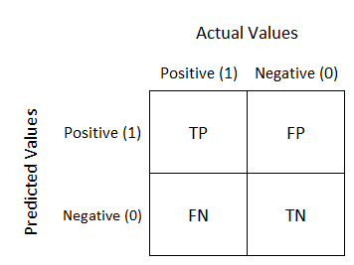

Problem Description
Essentially a binary classification problem.
Target: maximizes
$accuracy= \frac{TP+TN}{TP+FP+FN+TN}$
Notes:
Of course adding some regularizations though

Slide 3
Data Description
DRIBBLES
TOUCH_TIME
SHOT_DIST
PTS_TYPE
SHOT_RESULT
CLOSEST_DEFENDER
CLOSEST_DEFENDER_PLAYER_ID
CLOSE_DEF_DIST
FGM
PTS
player_name
player_id
Data size: (128069, 21)
NBA shot logs | Kaggle (2014~2015)
GAME_ID
MATCHUP
LOCATION
W
FINAL_MARGIN
SHOT_NUMBER
PERIOD
GAME_CLOCK
SHOT_CLOCK

Slide 4
Data Description
DRIBBLES
TOUCH_TIME
SHOT_DIST
PTS_TYPE
SHOT_RESULT
CLOSEST_DEFENDER
CLOSEST_DEFENDER_PLAYER_ID
CLOSE_DEF_DIST
FGM
PTS
player_name
player_id
Data size: (128069, 21)
NBA shot logs | Kaggle (2014~2015)
GAME_ID
MATCHUP
LOCATION
W
FINAL_MARGIN
SHOT_NUMBER
PERIOD
GAME_CLOCK
SHOT_CLOCK
Notes:
Categorical variables

Slide 5
Methods
Logistic regression
SVM with rbf kernel
Boosting methods:
XGBoost
CatBoost

Slide 6
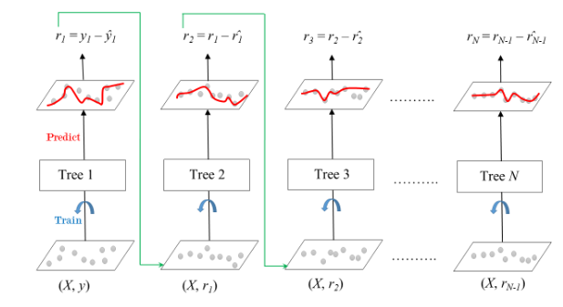
Boosting Methods in a Nutshell
Notes:
Tree methods works well on categorical variables
which shows that boosting performs gradient descent in a function space using a convex cost function.
Efficient, more accurate than random forests. Because we train them to correct each other's errors
Easily effect by outliers, tends to overfit, handle categorical variables in nature
Tree algorithms such as XGBoost and Random Forest can over-fit the data, especially if the trees are too deep with noisy data.
dealing with bias

Slide 7
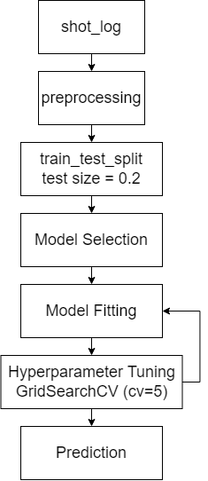
Experiments
Notes:
Remove, standardize, ohe
svm

Slide 8
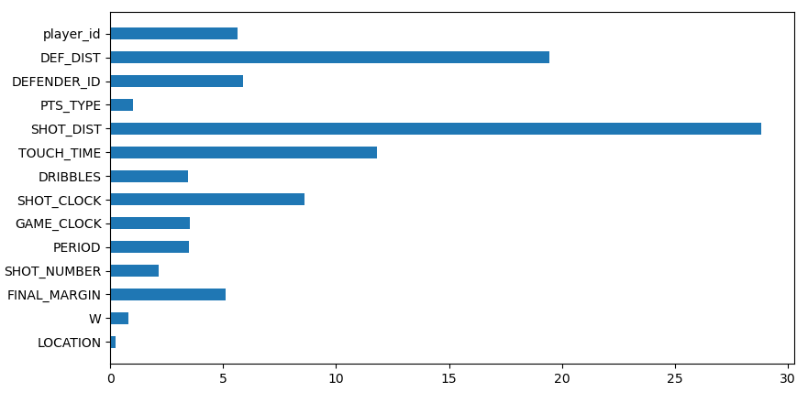
Result
Logistic regression
Accuracy: 0.60638
SVM
Accuracy: 0.61631
XGBoost
Accuracy: 0.61866
CatBoost
Accuracy: 0.61957
shot made:0.45615
Notes:
Boosting slightly better
Play id doesn’t have effect on the prediction much
Replace by height, weight, handedness, injury history, position
3. Defense pressure like facing double-teaming, Wide open or don’t believe you can shoot it in
speed, balance, height, left-handed, jumpshot, runningjumpshot, layup
Playing strategies
Playerid for quality of carrying out strategy, offending and defending; somewhat encapsulated by shot dist., def dist.

Slide 9
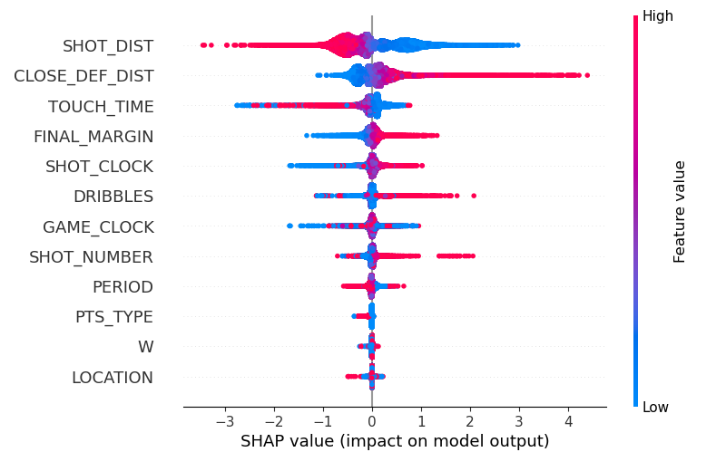
Result

Slide 10
Future Plan
Keep tuning the parameters…

Slide 11
Reference (pictures)
Understanding Confusion Matrix | by Sarang Narkhede | Towards Data Science
Charles Barkley quote: The only difference between a good shot and a bad... (azquotes.com)

Slide 12
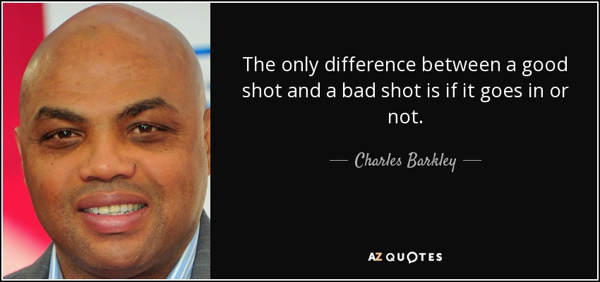
Problem Description

Slide 13
XGBoost in a Nutshell
XGBoost (Extreme Gradient Boosting), is a scalable, distributed gradient-boosted decision tree machine learning library.
Pros:
Highly flexible
Supports normalization
Utilize parallel processing

Slide 14
Some observations
Boosting methods are (slightly) better
Shot distance and Defense distance dominates
Data may not be sufficient for predicting a shot
Notes:
Precise coordination, height
Player id => height, weight
Quality of defender and attacker already reflect in the distance (kind of feature extraction)
Instant score margin

